Slide 1

AI-Driven Smart Energy Optimization and Carbon Analytics Platform
SRM INSTITUTE OF SCIENCE AND TECHNOLOGY
SCHOOL OF COMPUTING
DEPARTMENT OF COMPUTING TECHNOLOGIES
21CSP401L – MAJOR PROJECT / 21CSP402L - MAJOR PROJECT AND 21CSP403L - INTERNSHIP
Batch ID: 364
Student 1 Reg. No: RA2211003010480
Student 1 Name: Kavisha Arora
Student 2 Reg. No: RA2211003010706
Student 2 Name: Karan Bhambhani
Guide name: Nithiyanandam Sir
Designation: Department:

Slide 2
Problem Statement
Modern enterprises and institutions are experiencing a rapid increase in energy consumption due to digital transformation. This results in both financial cost escalation and environmental impact. Traditional energy monitoring systems mainly provide historical usage data but lack advanced capabilities such as predictive forecasting, anomaly detection, and sustainability analytics. Major limitations of current systems include fragmented energy reporting across devices and departments, absence of anomaly detection with source attribution, lack of predictive demand forecasting, inconsistent cost reporting, and no visibility into carbon emissions'-VISION addresses these challenges through an AI-driven analytics platform that provides: Predictive energy demand forecasting Residual Z-score anomaly detection Carbon emission trackingCentralised cost reporting using INR tariff utility Role-based access control for secure enterprise usage The system provides a unified dashboard that enables organizations to monitor, analyze, and optimize energy consumption while supporting sustainability goals.

Slide 3
Abstract
Energy optimisation and sustainability are critical concerns for modern enterprises. EN-VISION is an AI-Driven Smart Energy Optimisation and Carbon Analytics Platform that integrates predictive analytics, residual Z-score anomaly detection with source attribution, and sustainability assessment into a unified system. The platform utilises machine learning models to forecast energy demand, identify overconsumption patterns at device/zone/department level, and generate optimisation recommendations. A centralized INR tariff utility (Rs 8.2/kWh) standardises cost reporting. Additionally, it converts energy usage into carbon emission equivalents to support sustainability reporting. Through interactive dashboards with JWT-based role-based access control (Admin, User, Viewer), the system provides actionable insights for energy efficiency and environmental responsibility, aligning with SDG-7 and SDG-13.

Slide 4
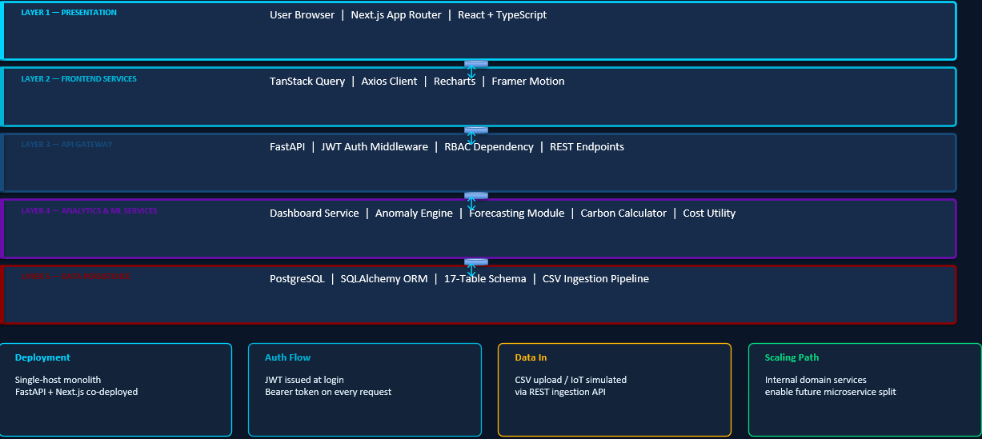
HIGH-LEVEL SYSTEM ARCHITECTURE
It adopts a monolithic architecture with service-oriented internal decomposition. A single FastAPI backend and Next.js frontend are deployed together with PostgreSQL as the shared database. Internally, code is split by domain — auth, ingestion, and dashboard analytics — giving clean boundaries. The five-layer stack flows from User Browser → Next.js Frontend → FastAPI API Gateway → Python Analytics/ML Services → PostgreSQL + SQLAlchemy ORM.
High-Level System Architecture

Slide 5
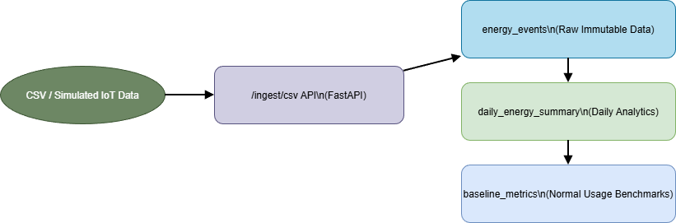
DATA FLOW ARCHITECTURE
The AI-Driven Smart Energy Optimization and Carbon Analytics Platform processes energy data through a structured pipeline that enables ingestion, processing, analytics, and visualization.
Energy consumption data is collected from CSV uploads or simulated IoT data sources through REST APIs. The ingestion layer validates and normalizes incoming records before storing them as raw immutable entries in the energy events table.
The stored data then passes through multiple processing stages. Raw event data is transformed into structured readings and aggregated into hourly and daily summaries through the energy_readings, energy_agg_hourly, and energy_agg_daily tables. These aggregated values are used to compute baseline metrics, including rolling baseline energy consumption and standard deviation for each device or department.
The analytics layer processes these metrics to generate insights such as anomaly detection, energy forecasting, cost estimation, and carbon emission analytics. Anomalies are detected using residual Z-score calculations based on deviations from baseline consumption.
Data Flow Architecture —Pipeline

Slide 6
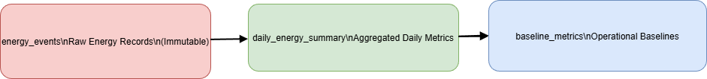
DATABASE DESIGN
The 17-table database architecture separates:
Raw Energy Data — energy_events, energy_readings (immutable IoT/CSV records)
Aggregated Data — energy_agg_hourly, energy_agg_daily (total/avg/peak kWh)
Baseline Metrics — baseline_metrics (rolling baseline_kwh + stddev per device/dept)
Analytics: carbon_emissions, energy_costs, daily_energy_summary, audit_logs | Assets: companies → locations → zones → departments → devices → meters | Auth: users (id, username, email, hashed_password, role, is_active)

Slide 7
Database tables
🏢 Asset Hierarchy
📊 Aggregated Data
⚡ Raw Energy Data
📐 Baselines
energy_agg_hourly
companies
energy_events
baseline_metrics
locations
energy_readings
energy_agg_daily
zones
departments
devices
Key Table Fields
meters
energy_events
id · device_id · timestamp · kwh · source_type · raw_metadata
baseline_metrics
device_id · dept_id · baseline_kwh · stddev · window_days
carbon_emissions
id · source_id · source_type · co2_kg · emission_factor · region
🔐 Auth
users
id · username · email · hashed_password · role · is_active · created_at
users
energy_costs
id · reading_id · cost_inr · tariff_rate · calculated_at
17
Total Tables
6
Asset Tables
5
Energy Tables
4
Analytics Tables
1
Auth Table
EN-VISION | AI-Driven Smart Energy Optimization & Carbon Analytics Platform
7 / 21

Slide 8
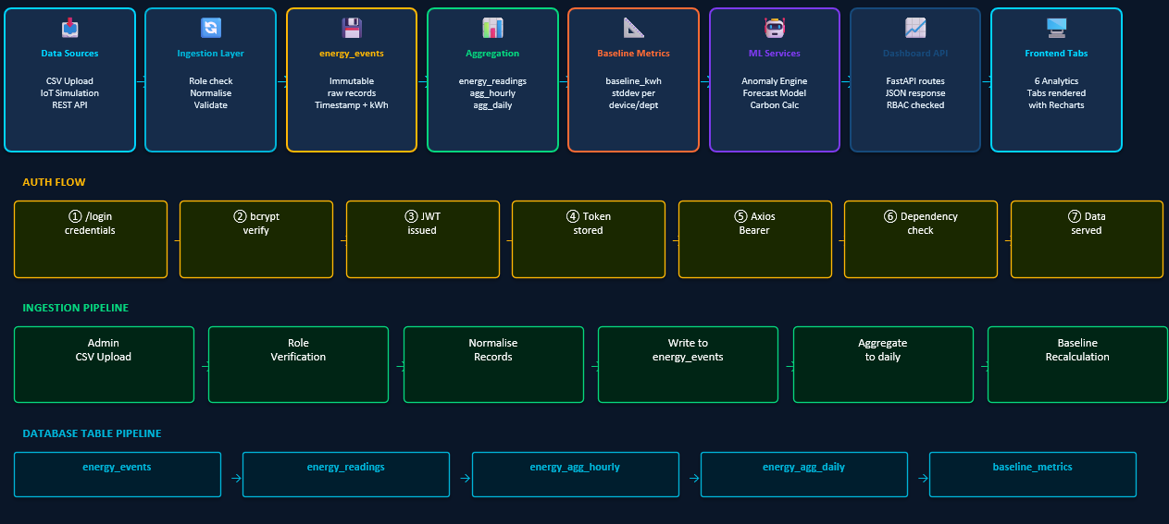
Data Flow Architecture

Slide 9
Functional Requirements
Functional Test Cases
ID | Test Case | Result
TC-01 | Successful login and JWT issuance | Passed
TC-02 | Invalid login credentials | Passed
TC-03 | Role-based tab visibility | Passed
TC-04 | Route protection without token | Passed
TC-05 | Anomaly source attribution | Passed
TC-06 | Filter shortcut functionality | Passed
TC-07 | Dual anomaly KPI display | Passed
TC-08 | Cost calculation using INR tariff | Passed
TC-09 | Profile update API | Completed
TC-10 | Password change API | Completed

Slide 10
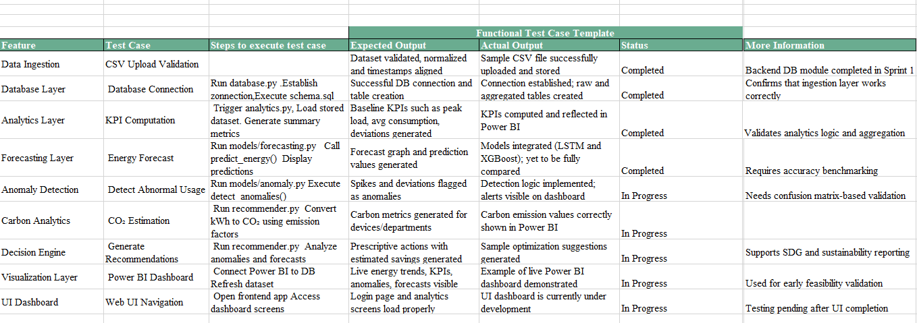
Functional Test Cases
Functional testing was conducted to validate all Sprint 2 deliverables: JWT authentication with RBAC, residual Z-score anomaly detection with source attribution, carbon emission analytics, centralised INR cost utility, profile/password management, dashboard tab rendering, CSV ingestion pipeline, and forecasting module output.
Testing results confirmed: correct JWT issuance and role enforcement; accurate anomaly Z-scores with source_device/zone/department metadata; consistent INR cost across all tabs; bcrypt password re-hashing; all 6 dashboard tabs rendering with correct data; and energy_events pipeline writing correctly through to daily aggregates.

Slide 11
Sprint Retrospective
Sprint Retrospective – Sprint 2
Sprint 2 was successfully completed with all five core objectives achieved. The team delivered the full-stack EN-VISION platform — FastAPI backend with auth, analytics, and ingestion service modules — integrated with the Next.js frontend featuring six analytics tabs: Home KPI, Energy Trends, Anomaly Insights, Forecasting, Carbon Analytics, and Power BI.
Authentication with JWT + bcrypt and role-based access control (Admin/User/Viewer) was fully implemented. The anomaly detection engine was corrected using residual Z-score scoring with source attribution and dual KPI metrics — Net Anomalies and Any-Device Anomaly Days. However, an anomaly baseline propagation bug required significant backend refactoring, and inconsistent cost currency representations were resolved through a centralised INR tariff utility (Rs 8.2/kWh).
Key learnings include the importance of centralising shared utilities early and validating data pipelines end-to-end before building the UI layer. In future sprints, automated testing coverage, configurable tariff rates, audit logging, and E2E test suites will be prioritised.

Slide 12
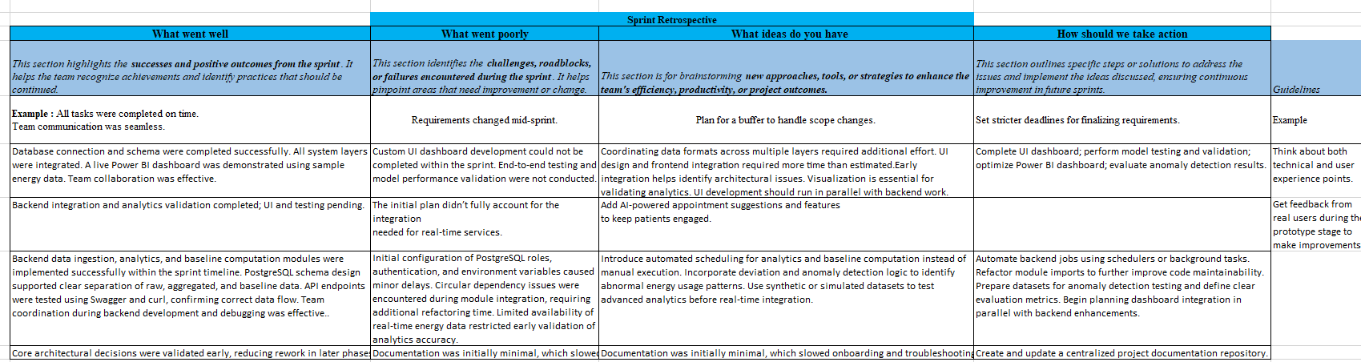
Sprint Retrospective Matrix : Sprint 2

Slide 13
Sprint Backlog
Sprint backlog refinement refers to a process that involves evaluating, prioritising, and subdividing specific user stories into bite-sized tasks that can be accomplished during a single sprint cycle. This aids in ensuring that implementation, workloads, and objectives are well-considered.
In this project, the sprint backlog refinement process was applied to break down the overall user requirements into executable technical tasks in each sprint.
Committed User Stories for Sprint 2
User Story 1 | As a system administrator, I want a secure JWT + bcrypt authentication system with role-based access control so that only authorised users can access the platform based on their assigned roles.
User Story 2 | As an energy analyst, I want a residual Z-score anomaly detection engine with source attribution so that I can investigate over-consumption at device, zone, or department level.
User Story 3 | As a sustainability manager, I want carbon emission analytics integrated into the dashboard so that I can monitor the organisation's carbon footprint.
User Story 4 | As a finance manager, I want energy cost calculations standardised in INR via a centralised tariff utility so that financial reporting is consistent. | As a registered user, I want to manage my profile and change my password so that I can maintain my account securely.

Slide 14
Outcome of Sprint Backlog Refinement
Clear mapping between all 5 user stories and their executable technical tasks was achieved.
Responsibilities were distributed between Kavisha (frontend, auth UI, carbon) and Karan (backend, anomaly engine, JWT) with joint integration tasks.
JWT + bcrypt auth with RBAC (Admin/User/Viewer), anomaly detection engine with Z-score scoring and source attribution, and all 6 dashboard tabs successfully delivered.
Carbon analytics, forecasting, INR cost standardisation, and profile/password management all completed and validated end-to-end.

Slide 15
Authentication and Role Based Access Control
LOGIN & TOKEN FLOW
🌐 Browser /login page
→
📤 POST /auth/login
→
🔐 bcrypt Verify Hash
→
🎫 JWT Token Issued
→
🍪 Token Stored
→
📡 Axios Bearer Header
→
→
✅ FastAPI Validate JWT
📊 Dashboard Data Served
AUTH ENDPOINTS
/auth/login
/auth/me
/auth/logout
/auth/profile
POST
GET
POST
PATCH
POST
Validate credentials → issue JWT
Return current user from token
Clear session token
Update username/email
/auth/change-password
bcrypt re-hash new password
ROLE-BASED ACCESS CONTROL
Dashboard Tab
Admin
User
Viewer
Home KPI
✅
✅
✅
Energy Trends
✅
✅
✅
Anomaly Insights
✅
✅
✅
Forecasting
✅
✅
❌
Carbon Analytics
✅
✅
❌
Power BI / Reports
✅
❌
❌
EN-VISION | AI-Driven Smart Energy Optimization & Carbon Analytics Platform
8 / 21

Slide 16
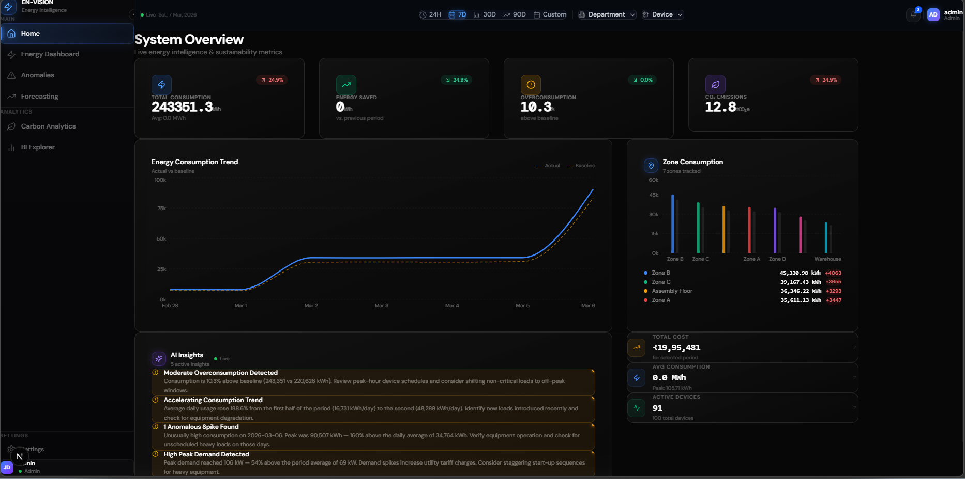
UI Dashboard: Home KPI

Slide 17
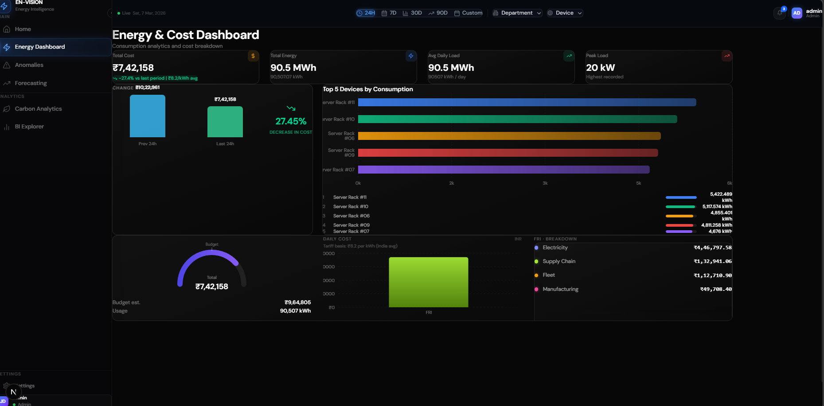
UI Dashboard: Energy and Cost Tab
Purpose: Anomaly Tab: Residual Z-score feed with severity chips (High/Medium/Low), source attribution (device, zone, dept), dual KPI cards (Net Anomalies + Any-Device Anomaly Days), and severity distribution chart. Carbon Tab: CO₂ timeseries with department-level breakdown using co2_kg = total_kwh × emission_factor.

Slide 18
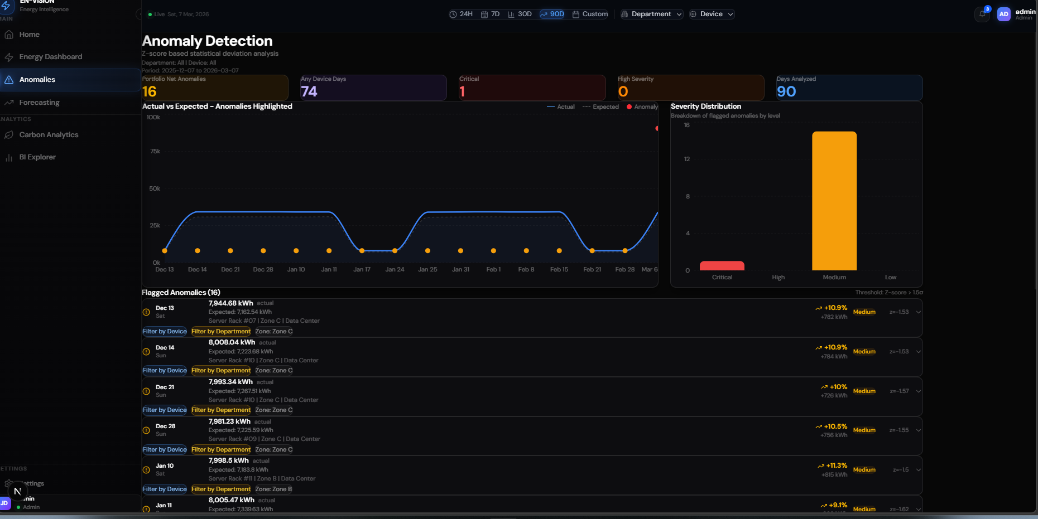
UI Dashboard: Anomalies Tab

Slide 19
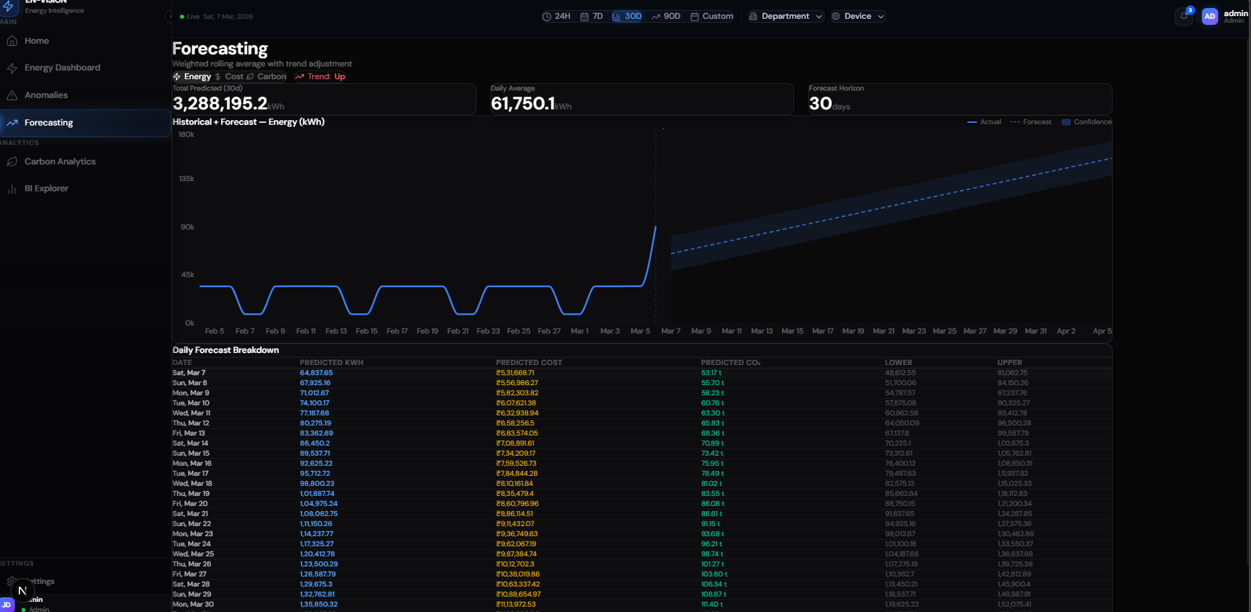
UI Dashboard: Forecasting Tab

Slide 20
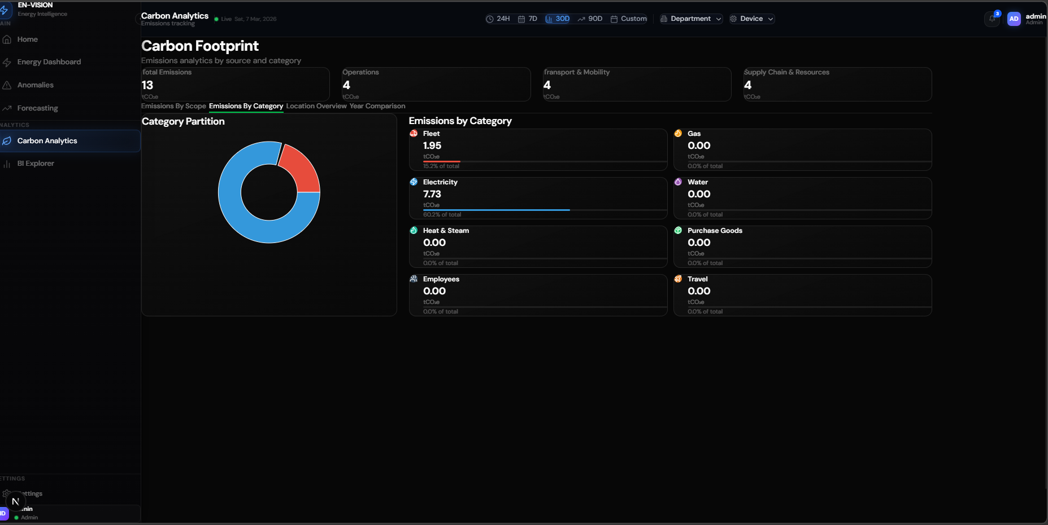
UI Dashboard: Carbon Tab

Slide 21
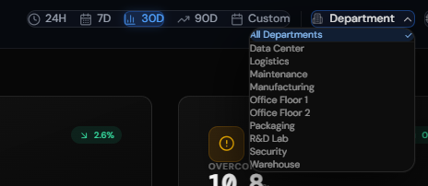
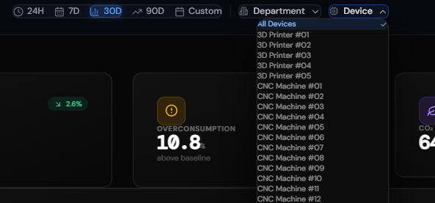
Department and Device Filters

Slide 22
Objectives
Design and develop - an AI-driven Smart Energy Optimisation and Carbon Analytics Platform enabling organisations to monitor, analyse, and optimise energy consumption in a structured and intelligent manner.
Collect and process energy data from CSV/IoT sources into daily analytics (energy_agg_daily) providing visibility across devices and departments. Establish rolling baseline_kwh per device/dept, enabling residual Z-score anomaly detection: anomaly_score = (actual_kwh − baseline_kwh) / stddev with High/Medium/Low severity classification.
Deliver predictive analytics via forecasting module (predicted_kwh with confidence bands), carbon emission estimation (co2_kg = total_kwh × emission_factor by source/region), and a centralised INR tariff utility (Rs 8.2/kWh) for consistent cost reporting. Implement JWT + bcrypt authentication with Admin/User/Viewer RBAC, and profile/password management APIs.
Provide a scalable, modular FastAPI + Next.js solution with a 17-table PostgreSQL schema, supporting energy efficiency, INR cost optimisation, and alignment with SDG-7 (Affordable and Clean Energy) and SDG-13 (Climate Action).

Slide 23
SDG Alignment
AI-Driven Smart Energy Optimization and Carbon Analytics Platform — aligns with the following United Nations Sustainable Development Goals (SDGs):
SDG 7 – Affordable and Clean Energy: Ensure access to affordable, reliable, sustainable, and modern energy for all. EN-VISION promotes efficient energy utilisation through AI-based monitoring, anomaly detection, and demand forecasting. It reduces power wastage by identifying anomalies via residual Z-score scoring. utilisationCentralised INR tariff utility (Rs 8.2/kWh) provides financial clarity for energy optimisation decisions within enterprises.
SDG 13 – Climate Action: Take urgent action to combat climate change and its impacts. EN-VISION calculates and visualises CO₂ emission equivalents (co2_kg = total_kwh × emission_factor) by department and source type. It assists organisations in measuring and reducing their carbon footprint through predictive insights and Scope 1/2/3 emission records. Supports ESG compliance and global sustainability objectives.

Slide 24
Conclusion
This Platform demonstrates how AI-driven analytics can transform traditional energy monitoring into an intelligent, predictive, and sustainability-focused system. By integrating energy monitoring, residual Z-score anomaly detection with source attribution and dual KPI metrics, energy demand forecasting, carbon emission estimation, JWT-based RBAC, and a centralised INR tariff utility, the platform enables organisations to optimise energy usage, reduce operational costs, and minimise environmental impact. The modular FastAPI + Next.js architecture with a 17-table PostgreSQL schema provides a strong foundation for future enhancements including real-time IoT integration, configurable tariff rates, automated audit logging, and enterprise-level deployment.

Slide 25
Sprint 2 — Key Outcomes Summary
Key Outcomes – Sprint 2
Core Architecture: FastAPI + Next.js full-stack platform delivered with 6 analytics tabs.
Anomaly Engine: Residual Z-score scoring with source attribution (device/zone/dept) and dual KPIs (Net Anomalies + Any-Device Anomaly Days).
Auth & RBAC: JWT + bcrypt with Admin/User/Viewer roles. Carbon & Cost: CO₂ analytics + INR tariff utility (Rs 8.2/kWh). Account Mgmt: /profile + /change-password delivered. Next: E2E tests, audit logging, configurable tariff.

